Slide 1

Vel Tech Rangarajan Dr. Sagunthala R&D Institute of Science and Technology
School of Computing
Department of Computer Science and Engineering
10211CS224 / FULL STACK APPLICATION DEVELOPMENT (JAVA)
END SEMESTER PROJECT REVIEW
Date: 06-05-2026
Smart Campus Event Management System
SDG: SDG No – SDG 4 – Quality Education
Presented By:
SUPRAJA K – VTU25927 – 23UECS0888
Courses Handling Faculty:
Dr. HAFIZUR RAHMAN

Slide 2
INTRODUCTION
1
Many colleges organize events such as workshops, seminars, and competitions regularly.
Students often miss event information due to lack of a centralized system.
Traditional methods like posters and manual announcements are inefficient.
Managing event registrations and participant details manually is difficult.
Therefore, a digital solution is needed to simplify event management.
The Smart Campus Event Management System provides a web-based platform for managing campus events.
Students can view event details and register online easily.
Administrators can create, update, and manage events efficiently.
2
3
4
5
6
7
8
9

Slide 3
PROBLEM STATEMENT
1
In many colleges, event management is still handled using manual methods such as posters, emails, or notice boards.
These methods make it difficult for students to stay updated about upcoming events.
Event registration and participant tracking are often done manually, which is time-consuming.
Organizers also face difficulty managing event schedules and participant data.
This leads to miscommunication and reduced student participation in events.
There is a need for a centralized digital platform to manage campus events efficiently.
The system should allow easy event creation, registration, and information sharing.
Therefore, a Smart Campus Event Management System is required to automate and simplify event management.
2
3
4
5
6
7
8
9

Slide 4
OBJECTIVE(S)
1
2
To design and develop a web-based Smart Campus Event Management System for managing campus events efficiently.
To implement features for event creation, event registration, and participant management.
To improve communication and accessibility of event information for students.
To evaluate the performance of the system in simplifying campus event management and participation.
3
4
5
6
7
8
9

Slide 5
PROPOSED SYSTEM
1
The proposed system is a web-based Smart Campus Event Management System for managing campus events digitally.
It allows administrators to create, update, and delete event details easily.
Students can view upcoming events and register online through the platform.
The system stores event information and participant data in a structured database.
It reduces manual work involved in event announcements and registrations.
The platform provides quick access to event details anytime and anywhere.
It improves communication between event organizers and students.
Compared to traditional methods, the system offers faster event management, better organization, and improved student participation.
2
3
4
5
6
7
8
9

Slide 6
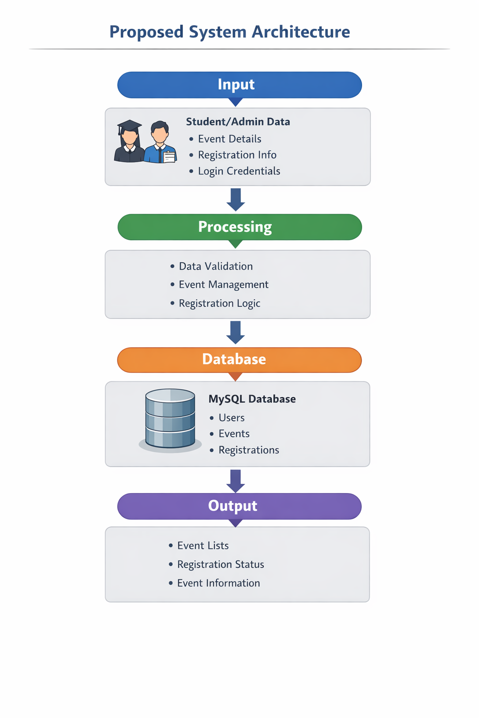
PROPOSED SYSTEM ARCHITECTURE
1
Input
The input stage includes the data entered by students and administrators through the web interface. This includes event details, student registration information, and login credentials.
Processing
In this stage, the system validates the input data and performs operations such as creating events, managing registrations, and handling user authentication.
Database
The database stores all the information related to users, events, and registrations. It ensures secure storage and allows the system to retrieve and update data when required.
Output
The output stage displays the processed information to the users. Students can view available events, registration confirmation, and event details through the web interface.
2
3
4
5
6
7
8
9

Slide 7
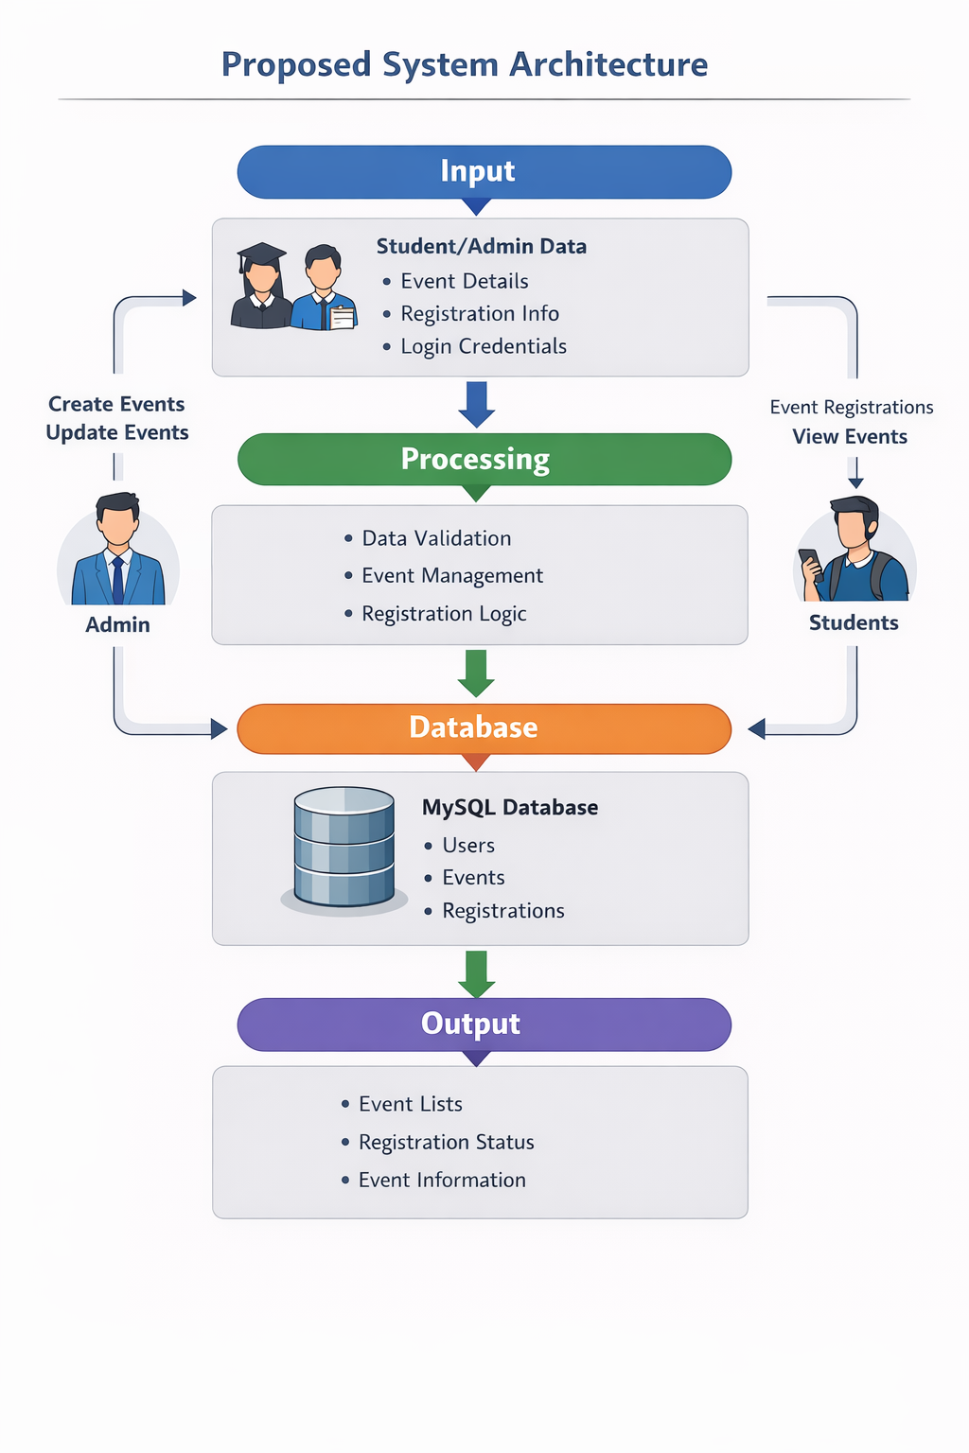
WORKFLOW
1
Admin Login: The administrator logs into the system using valid credentials.
Event Creation: The admin creates and publishes new events with details such as event name, date, time, and location.
Event Storage: The event information is stored securely in the database.
Student Login: Students log into the system to access the event management platform.
View Events: Students can browse the list of available and upcoming campus events.
Event Registration: Students select an event and register by submitting their details.
Data Processing: The system processes and stores registration details in the database.
Output/Confirmation: The system displays event information and registration confirmation to the students.
2
3
4
5
6
7
8
9

Slide 8
TECHNOLOGIES USED
1
Frontend: HTML, CSS, JavaScript – Used to design the user interface and web pages for event browsing, registration, and navigation.
Backend: Node.js with Express.js – Used to handle server-side logic, process requests, and manage event and user data.
Database: MySQL – Used to store information such as user details, event data, and registration records.
Tools: Visual Studio Code, GitHub, Web Browser – Used for coding, version control, and running the application.
Hardware/Software Requirements
Hardware: Computer/Laptop with minimum 4 GB RAM and internet connectivity.
Software: Operating System (Windows/Linux/Mac), Web Browser, Node.js runtime environment, and MySQL Database Server.
2
3
4
5
6
7
8
9

Slide 9
MODULE DESCRIPTION
1
Module 1: User Management Handles user registration and login for students and administrators. It ensures secure authentication and allows users to access the system based on their roles.
Module 2: Event Management Allows administrators to create, update, and delete campus events. This module manages event details such as event name, date, time, location, and description.
Module 3: Event Registration Enables students to browse available events and register online. It stores participant information and manages the list of registered students.
Module 4: Database Management Manages the storage and retrieval of data related to users, events, and registrations while ensuring data consistency and security.
2
3
4
5
6
7
8
9

Slide 10
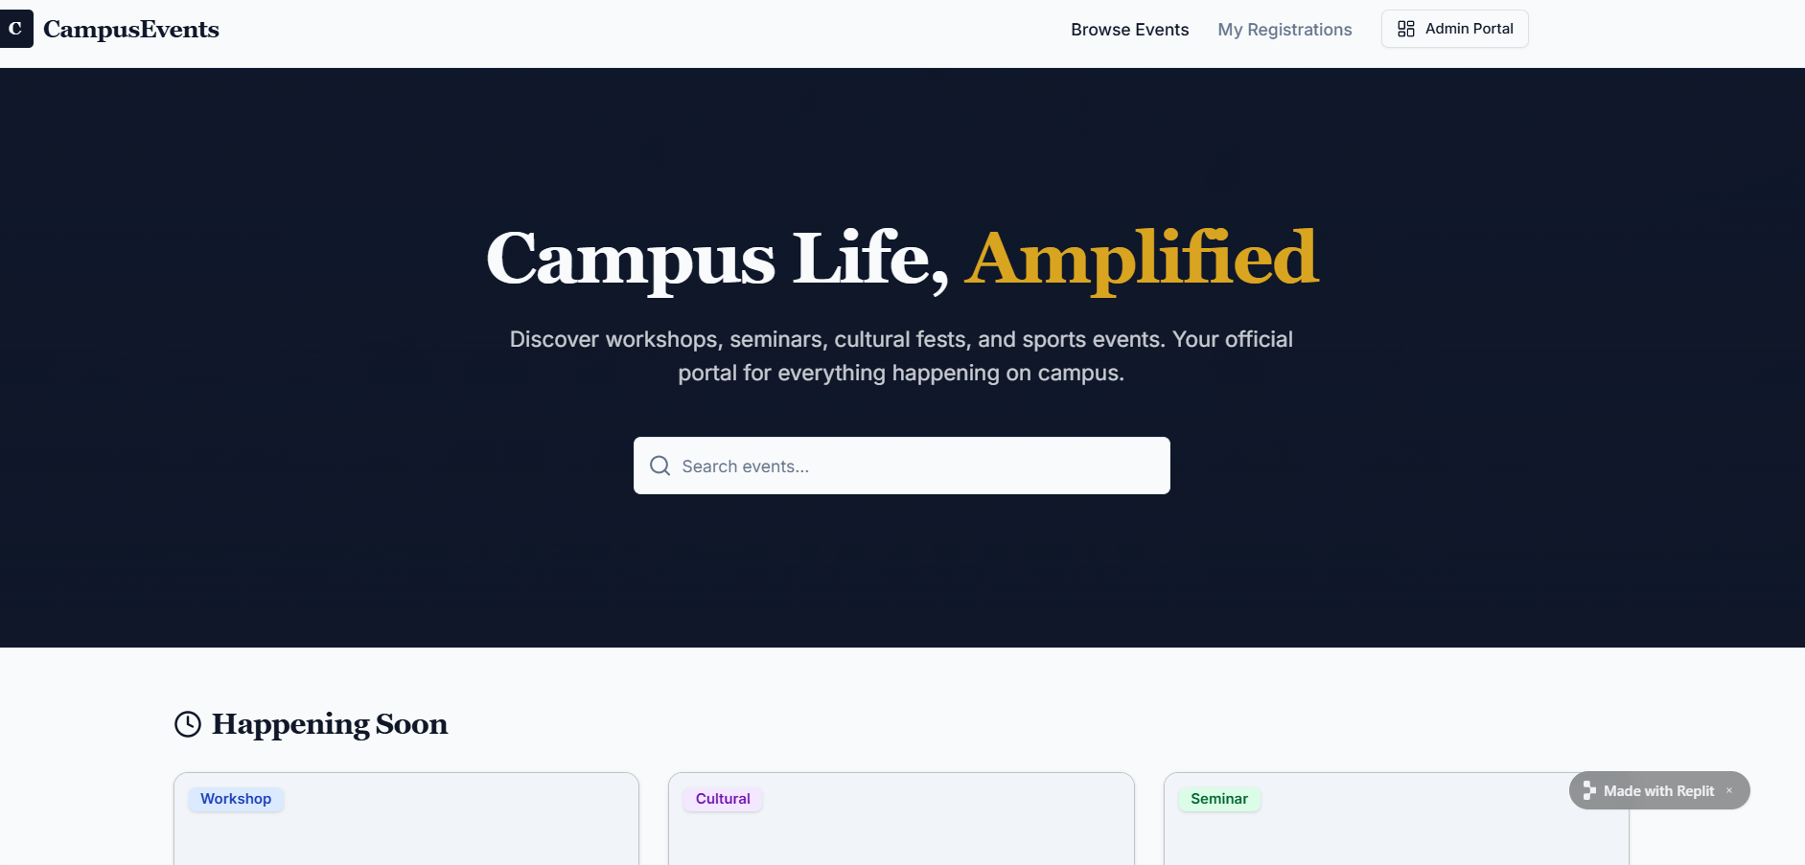
IMPLEMENTATION SCREENSHOTS
1
2
3
4
5
6
7
8
Home Page The home page introduces the Smart Campus Event Management System and displays information about upcoming campus events. Users can navigate to login or view event details from this page.
2. Login Page The login page allows registered students and administrators to securely access the system using their username and password.
9

Slide 11
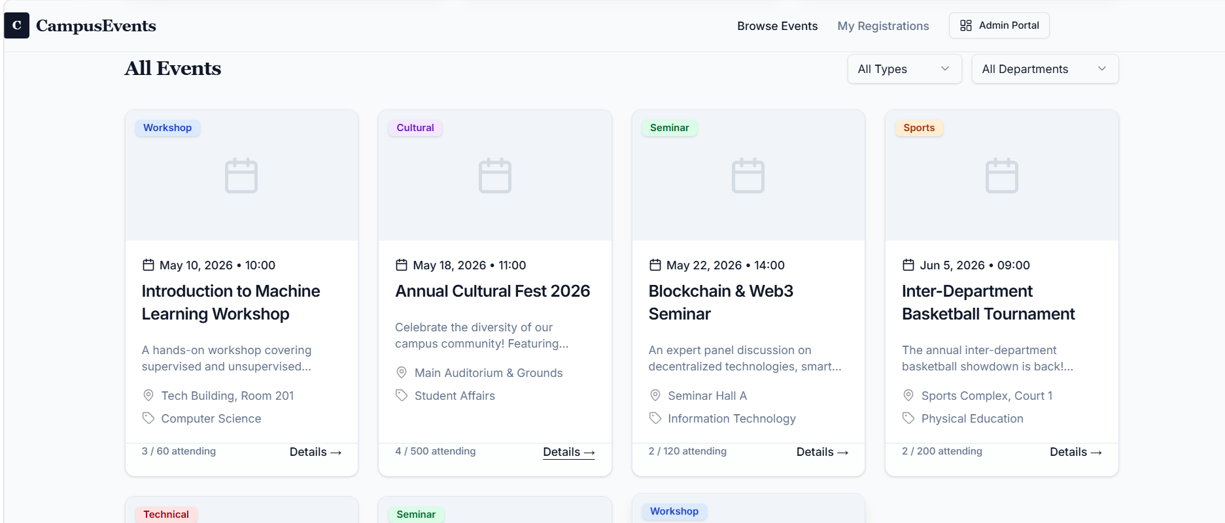
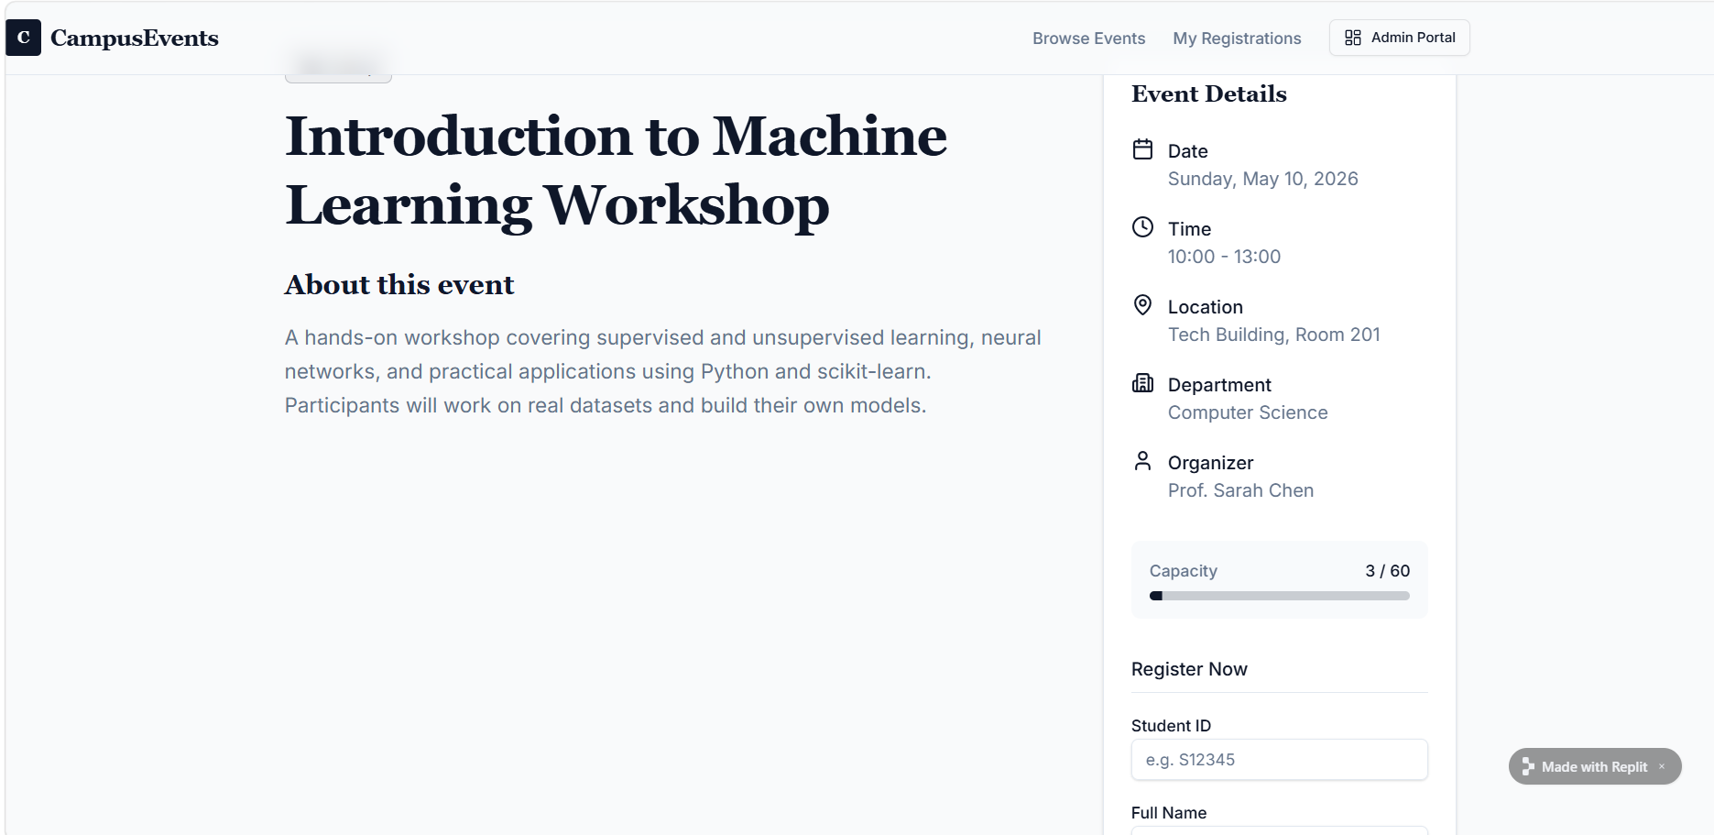
IMPLEMENTATION SCREENSHOTS
1
2
3
4
5
6
7
8(A)
3. Main Module (Event Management Page) In the main module, administrators can create and manage events, and students can browse available events and register for them.
4. Output Page The output page displays the results such as event lists, registration confirmation, and event details for the users.
9

Slide 12
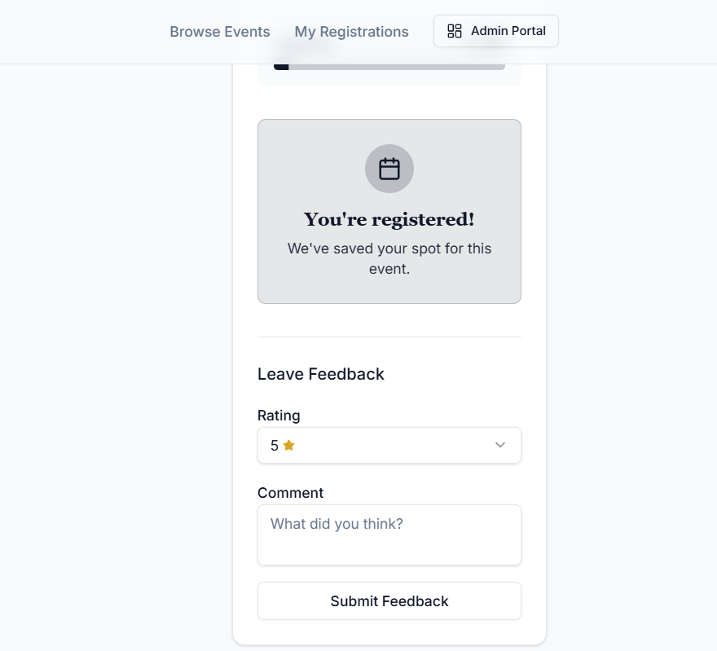
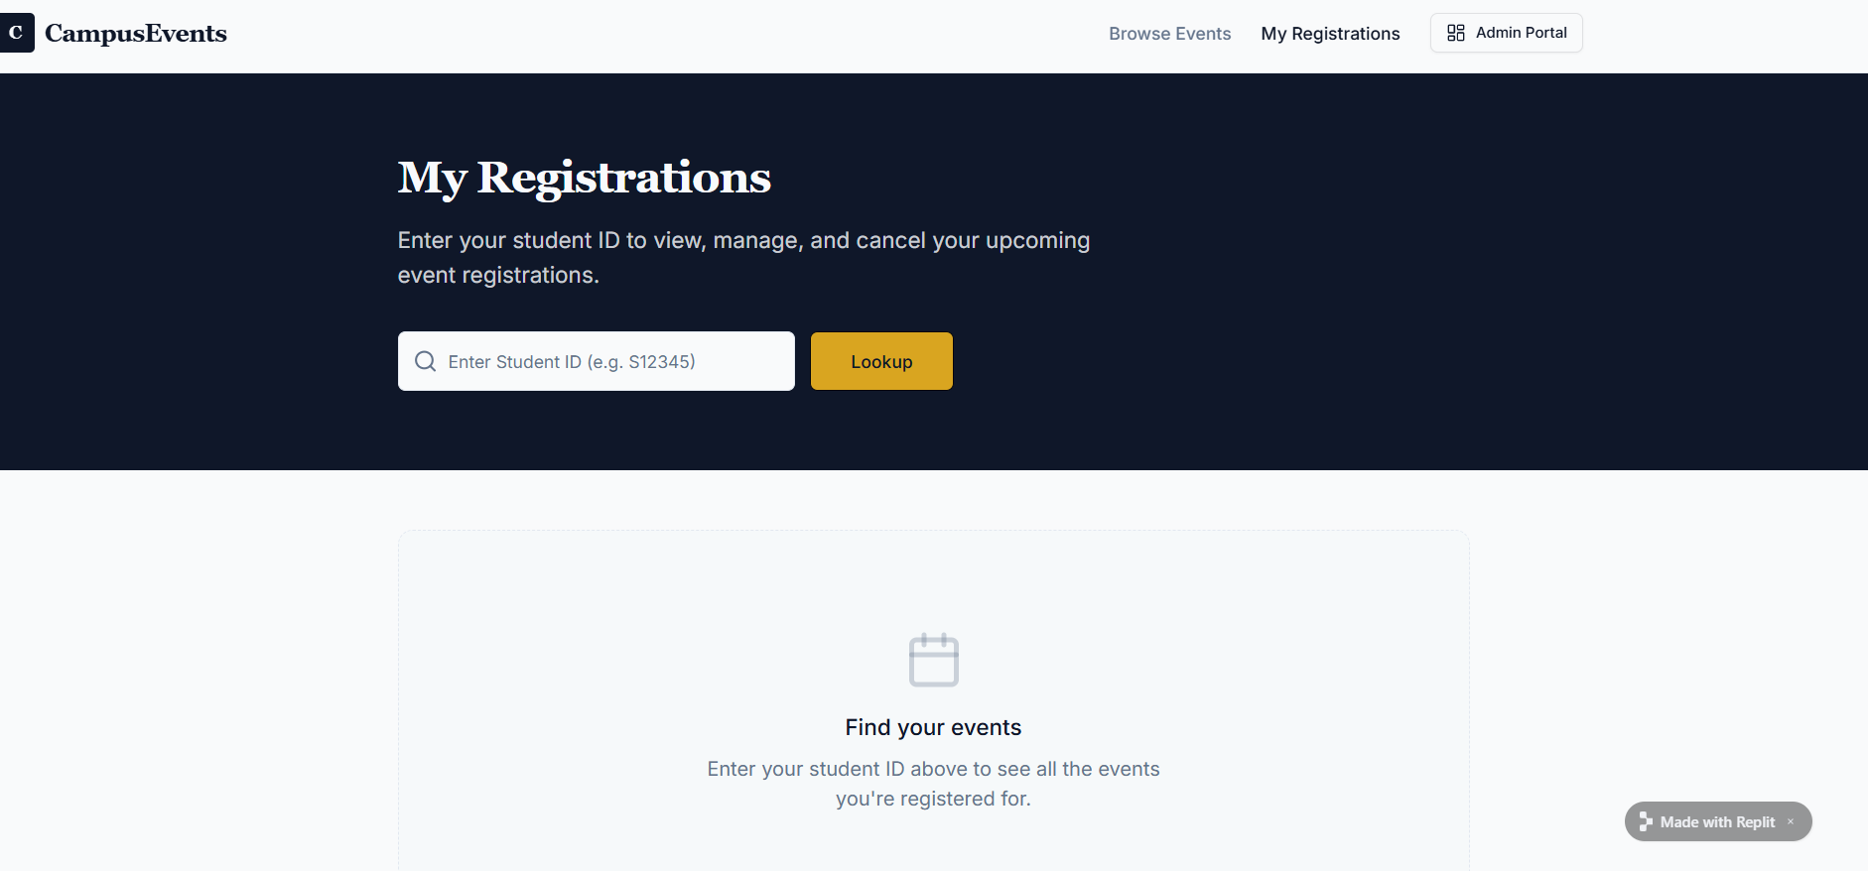
IMPLEMENTATION SCREENSHOTS
1
2
3
4
5
6
7
8(B)
9

Slide 13
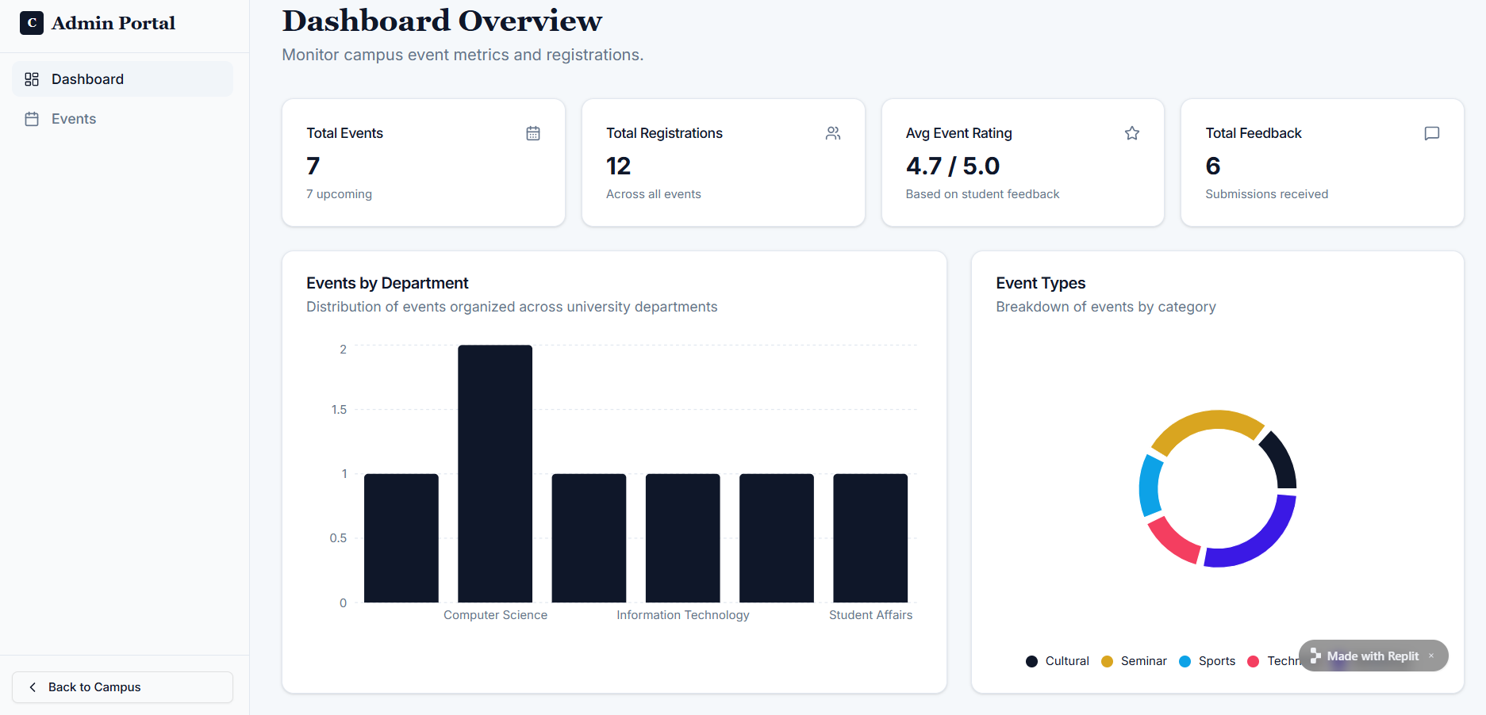
IMPLEMENTATION SCREENSHOTS
1
2
3
4
5
6
7
8(C)
9

Slide 14
ADVANTAGES & LIMITATIONS
Advantages
Provides a centralized platform for managing all campus events.
Allows students to view and register for events online easily.
Reduces manual work and paperwork in event management.
Improves communication between organizers and students.
Stores event and registration data in an organized database.
User-friendly interface makes the system easy to use for students and admins.
Limitations
Requires internet connectivity to access the system.
Users must log in to view and register for events.
System functionality depends on proper server and database maintenance.
Data security depends on correct database protection and authentication mechanisms.
1
2
3
4
5
6
7
8
9

Slide 15
Thank you

